Slide 1
Visualizing QTL using Python
Sydney Graham

Slide 2
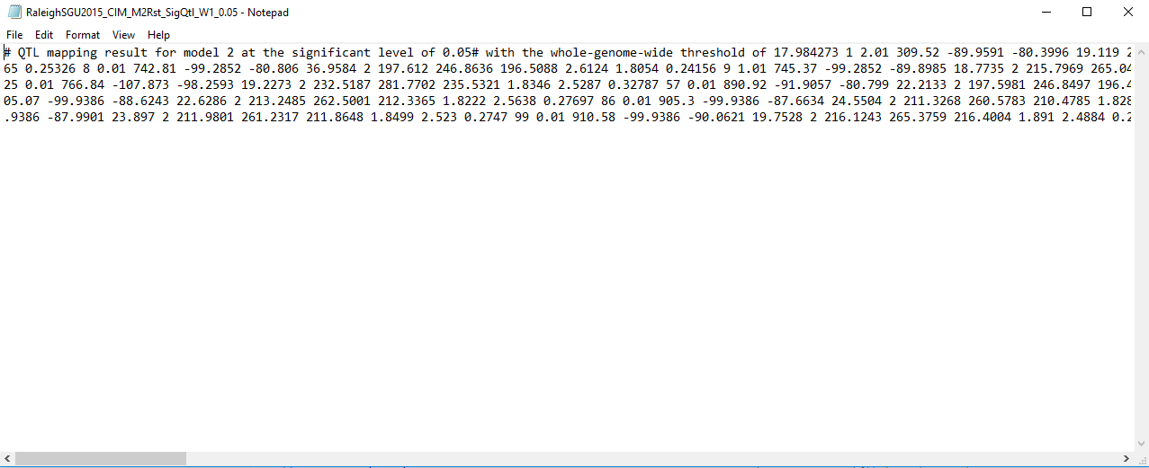
Data Input

Slide 3
Plotting Strategy
Create a main plot with subplots for individual environments
Column of each trait
Row for each environment
Use histogram with cumulative position on X-axis
At each position Y-value will be either 0 or 1
Challenge: Getting bars to appear in figures because there are so many small bins
Potential Fault: Indicates location of peak for QTL but no information about range

Slide 4
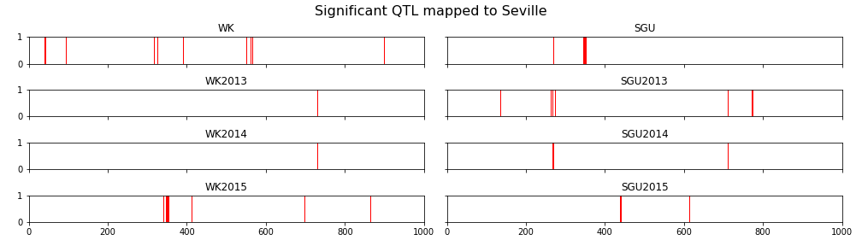
QTL Plot

Slide 5
Future Work
Create similar image with QTL Mapped to Raleigh
Use significance to determine transparency of the line
Create vertical lines to indicate linkage groups
…circos plot in R?

